Slide 1

Stacks and Queues
The Design Decision Hierarchy: choosing the right ADT, evaluating data structures, and reasoning about invariants.
Kevin Lin, with thanks to many others.
Notes:
Ask questions anonymously on Piazza. Look for the pinned Lecture Questions thread.

Slide 2
Feedback from the Reading Quiz
Demo
How does ArrayList.removeFront actually work?
Why is the implementation of ArrayList.removeFront related to ArrayList.get?
What’s the relationship between representation invariants, data structures, and ADTs?
Generics allow us to write a single ArrayList<T> class that can store any single data type T without needing to create specialized classes for ArrayIntList, ArrayStringList, …
It’s okay if you don’t feel comfortable with everything just yet.
We’ll look at more examples today, week 3, and week 4.
(For week 2, we’ll discuss program correctness and running time.)
Notes:
The reading discussed representation invariants and gave a brief introduction to the Stack and Queue ADTs.

Slide 3
Implementer’s Design Decision Hierarchy
Abstract Data Type
Which ADT is the best fit?
Data Structure
Which data structure offers the best performance for our input/workload?
Implementation Details
How do we maintain invariants?
List
Resizable Array
Linked Nodes
data is an array of items, never null. The i-th item in the list is always stored in data[i].
Notes:
?: How do we determine whether one data structure is faster than another? Does it depend on the implementation details?
?: How do invariants relate to data structures?

Slide 4
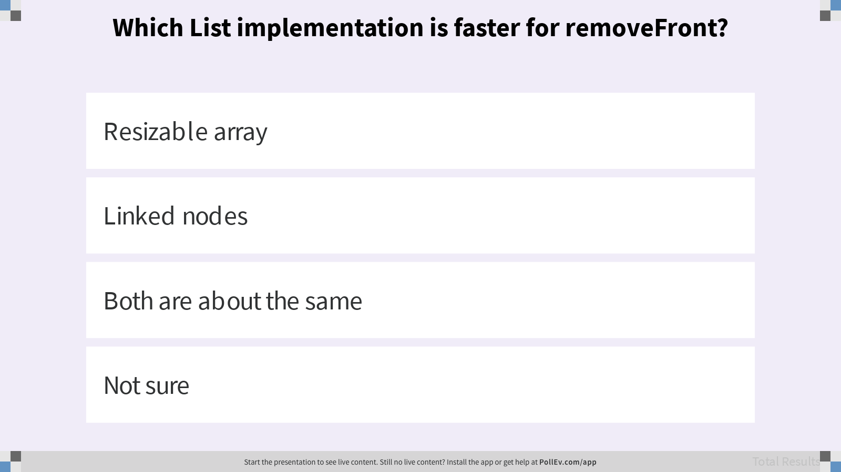
Which List implementation is faster for removeFront?

Slide 5
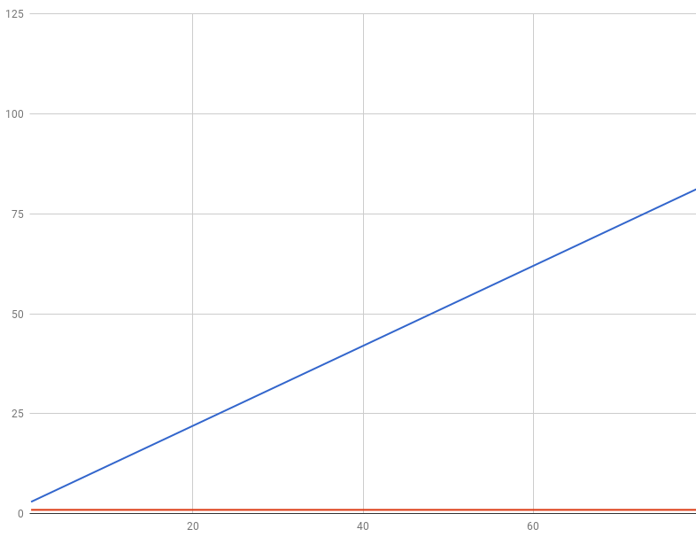
Big-O Runtime Analysis
What does it mean for a data structure to be slow or fast?
Big-O runtime analysis: count how many steps a program takes to execute an input of size N.
Suppose our list has N items.
A method that takes a constant number of steps (e.g. 23) is in O(1).
A method that takes a linear number of steps (e.g. 4N + 3) is in O(N).
Number of steps (runtime)
O(N)
O(1)
Size of input (N)
Notes:
?: How does constant or linear relate to analyzing runtime “with respect to big inputs”?
?: What are the big-O runtimes for ArrayList and LinkedList removeFront?
?: Can we say that an ADT is slower or faster than another ADT?

Slide 6
ArrayList vs. LinkedList
Q
Which List implementation should we use to store a list of songs in a playlist?
Which List implementation should we use to store the history of a bank customer’s transactions?
Which List implementation should we use to store the order of students waiting to speak to a TA at a tutoring center?
Notes:
Time needed to access the i-th item from a list of N items.
ArrayList: O(1)
LinkedList: O(N)
Time needed to insert an item at position i in a list of N items.
ArrayList: O(N)
LinkedList: O(N)
?: Why are these runtimes what they are?
Q1: Which List implementation should we use to store a list of songs in a playlist?
Q2: Which List implementation should we use to store the history of a bank customer’s transactions?
Q3: Which List implementation should we use to store the order of students waiting to speak to a TA at a tutoring center?

Slide 7
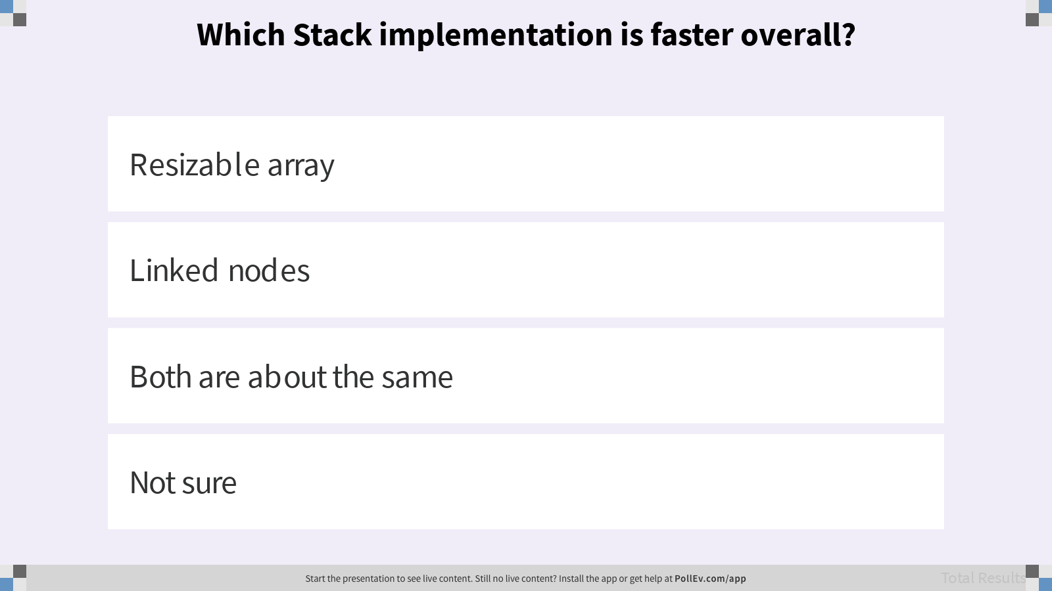
Which Stack implementation is faster overall?
Notes:
Recall that the Stack ADT specifies two important methods:
push(Item item): Puts the item on the top of the stack.
Item pop(): Removes and returns the top item of the stack.
Assume for the resizable array that we use the addLast and removeLast methods from ArrayList. Assume for linked nodes that we use the addFirst and removeFirst methods from LinkedList, and we have a reference to the front of the LinkedList.

Slide 8
ArrayStack
push(3)
push(4)
pop()
push(5)
push
0 | 1 | 2 | 3
State
3
3 | 4
3 | 4
3 | 5
Item[] data
int size
0
1
2
1
2
size
pop
Behavior
Runtime
push – resize data array if necessary; assign data[size] = item; increment size
pop – return data[size]; decrement size
push – O(1) if not resizing; O(N) if resizing
pop – O(1)
Notes:
?: How do the Stack ADT methods compare to List ADT methods?
?: How do the implementations for ArrayList methods differ from ArrayStack methods?

Slide 9
LinkedStack
top
top
top
top
push(3)
push(4)
pop()
push
State
4
3
3
3
Node top
int size
0
1
2
pop
size
1
size
size
size
Behavior
Runtime
push – create a new node linked to top; update top to new node; increment size
pop – return top item; update top; decrement size
push – O(1) always
pop – O(1)
Notes:
?: If the push and pop operations of LinkedStack is always at least as good or better than ArrayStack, would we ever want to use ArrayStack?

Slide 10
ArrayList vs. LinkedList
Which List implementation should we use to store a list of songs in a playlist?
Which List implementation should we use to store the history of a bank customer’s transactions?
Which List implementation should we use to store the order of students waiting to speak to a TA at a tutoring center?
Queue

Slide 11
Hiding Program Complexity
Q
Contract: Assuming they agree to the ADT’s possible values and operations, the client and the implementer can improve their programs at the same time.
Invariants: A checklist of assumptions the implementer needs to maintain every time they add a behavior to a data structure.
If the List ADT does everything the Stack and Queue ADTs can do, why use Stack or Queue instead of List?
Client
ADT
Implementer
Notes:
?: How do invariants affect the implementation of ArrayList and ArrayStack?
Q1: If the List ADT does everything the Stack and Queue ADTs can do, why use Stack or Queue instead of List?

Slide 12
ArrayQueue: Design 1
Same design as ArrayStack: borrow ArrayList’s addLast and removeFront.
It’s basically just an ArrayList.
add
0 | 1 | 2 | 3
remove

Slide 13
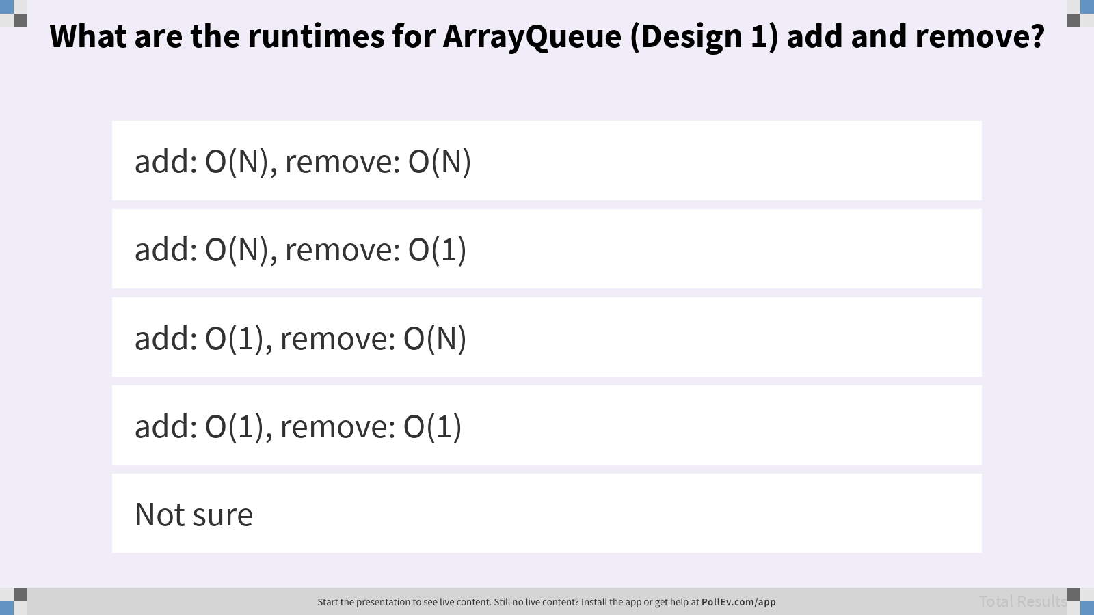
What are the runtimes for ArrayQueue (Design 1) add and remove?

Slide 14
Reconsidering Data Structure Invariants
Q
ArrayQueue (Design 1) is basically just an ArrayList.
Recall the representation invariant for the underlying data array in an ArrayList.
data is an array of items, never null. The i-th item in the list is always stored in data[i].
How does maintaining this invariant affect the runtimes for add and remove?
Propose an invariant that could result in faster runtimes for add and remove.
Notes:
Q1: How does this invariant relate to the runtimes for add and remove?
Q2: Propose an invariant that could result in faster runtimes for add and remove.

Slide 15
ArrayQueue: Design 2
Removing items increments front
A
The i-th item does not need to be data[i] so the front of the queue does not need to be the front of the array!
0
front
1
0
1
2
3
0
back
1
Circular
add(3)
add(4)
remove()
add(5)
add(6)
add(7)
add
0 | 1 | 2 | 3
3
3 | 4
3 | 4
3 | 4 | 5
3 | 4 | 5 | 6
7 | 4 | 5 | 6
remove
0
1
2
1
2
3
size
4
Notes:
front represents the index of the front of the queue (except when the queue is empty) while back represents the index for the next item.
?: What’s the runtime for ArrayQueue (Design 2) add and remove?
?: Is it necessary to maintain an integer index for remembering the back of the array?
?: We found a faster way to implement ArrayQueue. Is it possible to take these invariants and use them to implement a faster ArrayList?

Slide 16
ArrayQueue: Design 2
Removing items increments front
Q
The i-th item does not need to be data[i] so the front of the queue does not need to be the front of the array!
Give an invariant that describes this behavior in your own words.
front
1
back
1
Circular
add
0 | 1 | 2 | 3
7 | 4 | 5 | 6
remove
size
4
Notes:
front represents the index of the front of the queue (except when the queue is empty) while back represents the index for the next item.
Q1: Give an invariant that describes this behavior in your own words.

Slide 17
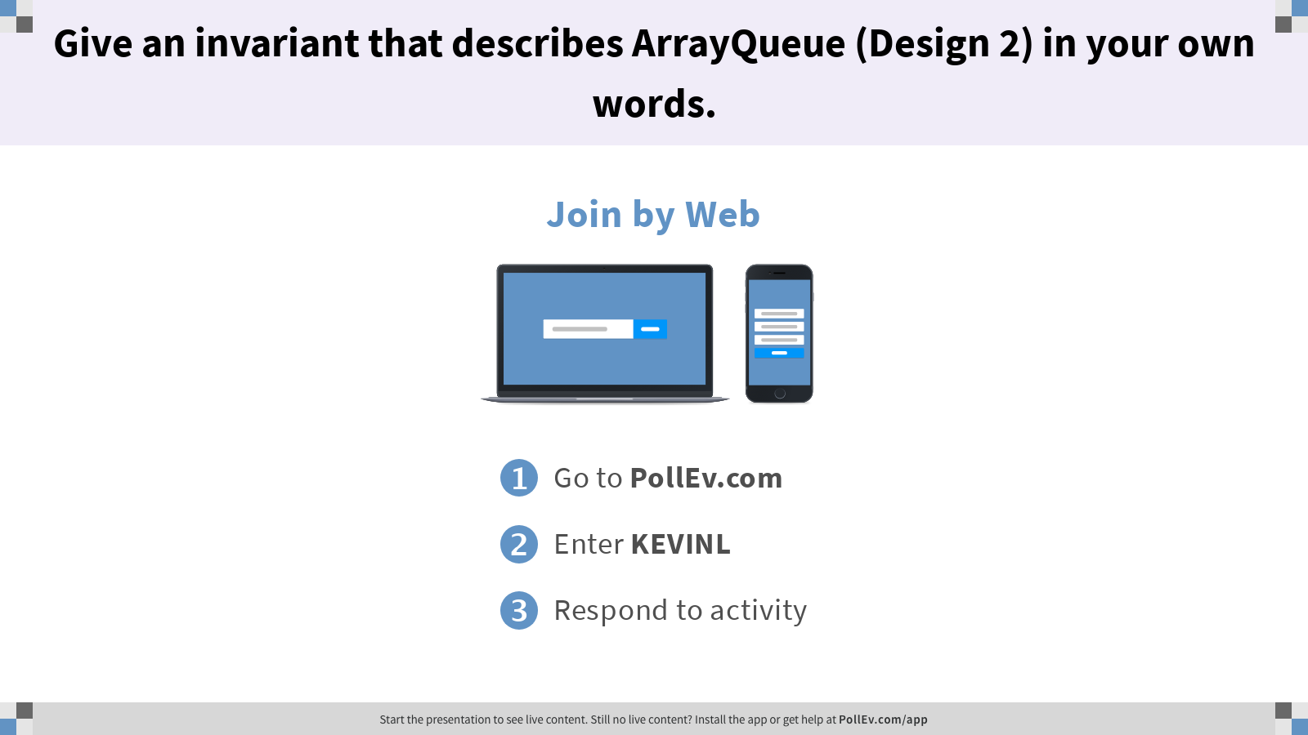
Give an invariant that describes ArrayQueue (Design 2) in your own words.

Slide 18
LinkedQueue: Design 1
Q
Same design as LinkedStack: borrow LinkedList’s addLast and removeFront.
Which method has a worse runtime: add or remove?
How could we improve the runtime?
back
add
4
3
remove
Notes:
Q1: Which method has a worse runtime: add or remove?
Q2: How would you improve the runtime?
?: How does this change your visualization of the data structure?

Slide 19
LinkedQueue: Design 2
A
Add a front pointer.
back
add
4
3
remove
front
Notes:
?: What are other possible designs for LinkedQueue? What set of invariants can result in a slower LinkedQueue implementation?

Slide 20
Implementer’s Design Decision Hierarchy
Abstract Data Type
Which ADT is the best fit?
Data Structure
Which data structure offers the best performance for our input/workload?
Implementation Details
How do we maintain invariants?
List
Resizable Array
Linked Nodes
data is an array of items, never null. The i-th item in the list is always stored in data[i].
Notes:
Today, we studied the ADT implementer’s view of the Design Decision Hierarchy. A recurring theme in computer science is that problem representations (implementation details) reflect problem solutions (data structures).
One neat observation: by simplifying the ADT interface, we gave the implementer more control over how they implemented their data structures. The more complex the ADT, the more restrictive the invariants, which means the implementer might not be able to make as many runtime optimizations.
?: We’ll later look at the ADT client’s perspective. How does the client determine which ADT is the best fit? To what extent does the client need to worry about ADT and data structure complexity?

